Slide 1

End Semester Presentation
on
A Recipe Sharing Experience: Built with Full Stack Technology
------------ Team 13 ------------
Team Members :
P Sai Teja BL.EN.U4AIE21095
P Dinesh Saravan BL.EN.U4AIE21099
M Sai Subhash BL.EN.U4AIE21113
S Venkata Mahesh BL.EN.U4AIE21117
Date: 29-11-2024
Course : Full Stack Development – 21AIE465
AIE 7th sem – E Sec

Slide 2
Contents
Introduction
Objective
Literature Survey
Design
Conclusion and future work
References

Slide 3
Introduction
The Recipe Sharing Platform is a user-focused application designed to bring together food enthusiasts, enabling them to share, explore, and discover new recipes in an interactive and engaging environment.
It offers features like secure login, recipe browsing, sharing, and deleting, all within a visually appealing and user-friendly interface.
With a focus on intuitive design and robust functionality, the platform provides a seamless experience, connecting culinary creators and enthusiasts in the digital space.

Slide 4
Objective
Providing a platform where users can easily upload, share, and discover diverse recipes from various cuisines.
Allow users to easily create, upload, and share their recipes with others.
Provide functionality for users to save their favourite recipes for easy access later.
Offer a robust search system to help users find recipes based on item name (ex: Dosa, Biryani).
Foster a community-driven environment where users can exchange ideas, learn, and grow their culinary skills.

Slide 5






Tools used

Slide 6
Literature survey
Title: Foodies Full Stack Web Application: Connecting You to Your College Canteens
Published on: 2024 (journal)
Authors: S. S. Pawar
The Foodies Full Stack Web Application to enhance the colleges canteen service. Developed based on the contemporary Web technologies, the app combines the front-end and the back-end facilities. It uses Spoonacular API to get the details about the menu as well as the nutrition values and it also features an ML to recommend a diet plan. This technologies provides an enhanced and efficient human friendly interface through enabling the students and owners of the canteen to share information as far as food choices are concerned.

Slide 7
Literature survey
Title: A Proposal of an Interactive Web Application Meal Appeal: One Stop Solution for all Meals
Published on: 2022
Authors: Harshee Pitroda
It is a web-based framework created to improve home cooking experiences within the context of the COVID-19 pandemic. It adopts a total full-Stack architecture it uses React.js for developing the frontend part, while for the backend development, it uses Node.js and express framework and as for the database management, it uses MySQL. The application also has the social component that include the chat where application users can interact, as well as recipe exchange interface and the graphical user interface that visualizes the user activity in real time. Also, a questionnaire was given to users in order to know their choice in the process of creating features concerning various requirements for nutrition and culinary abilities as well as encouraging healthy and inspiration cooking

Slide 8
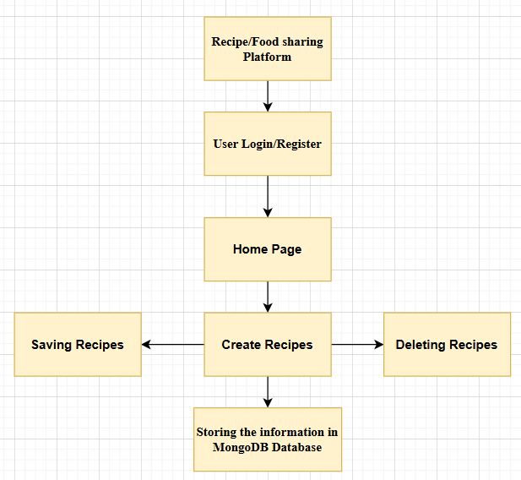
Flow Diagram:

Slide 9
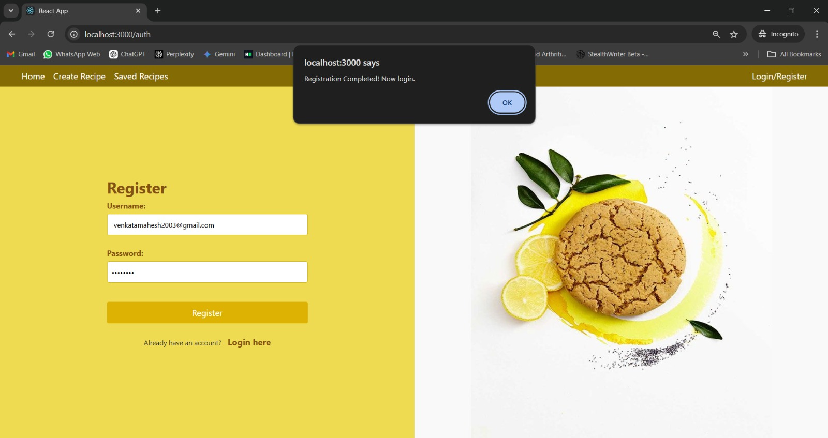
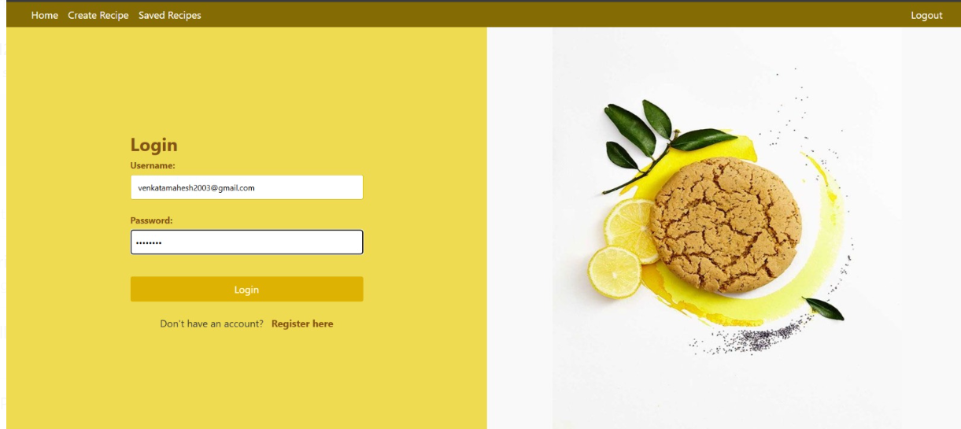
Results

Slide 10
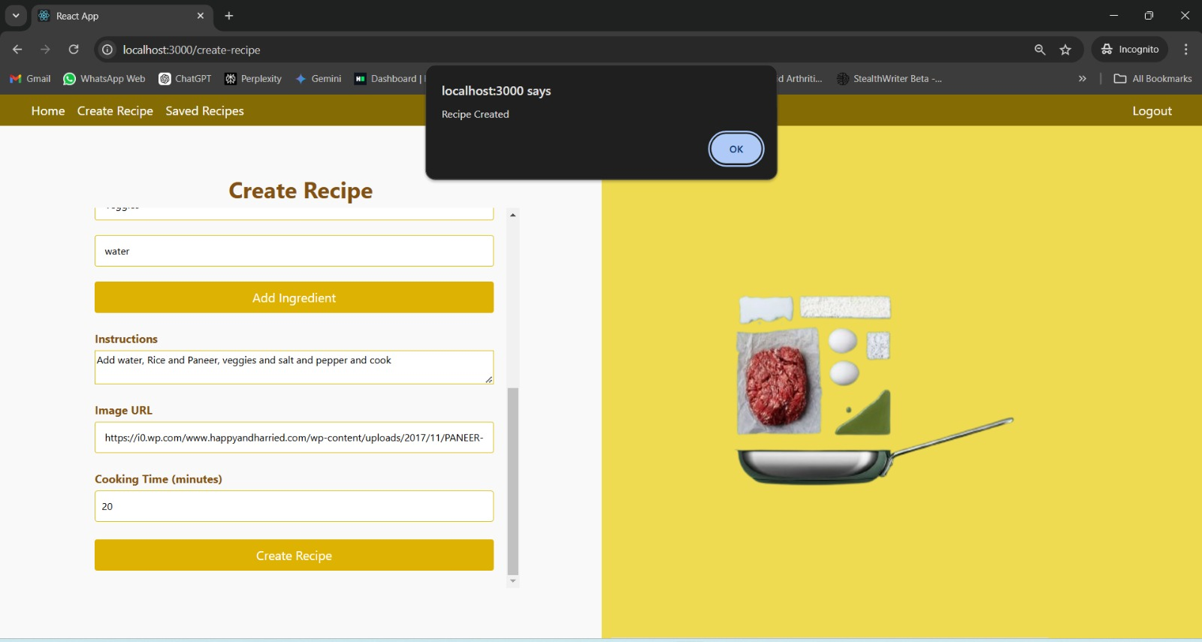
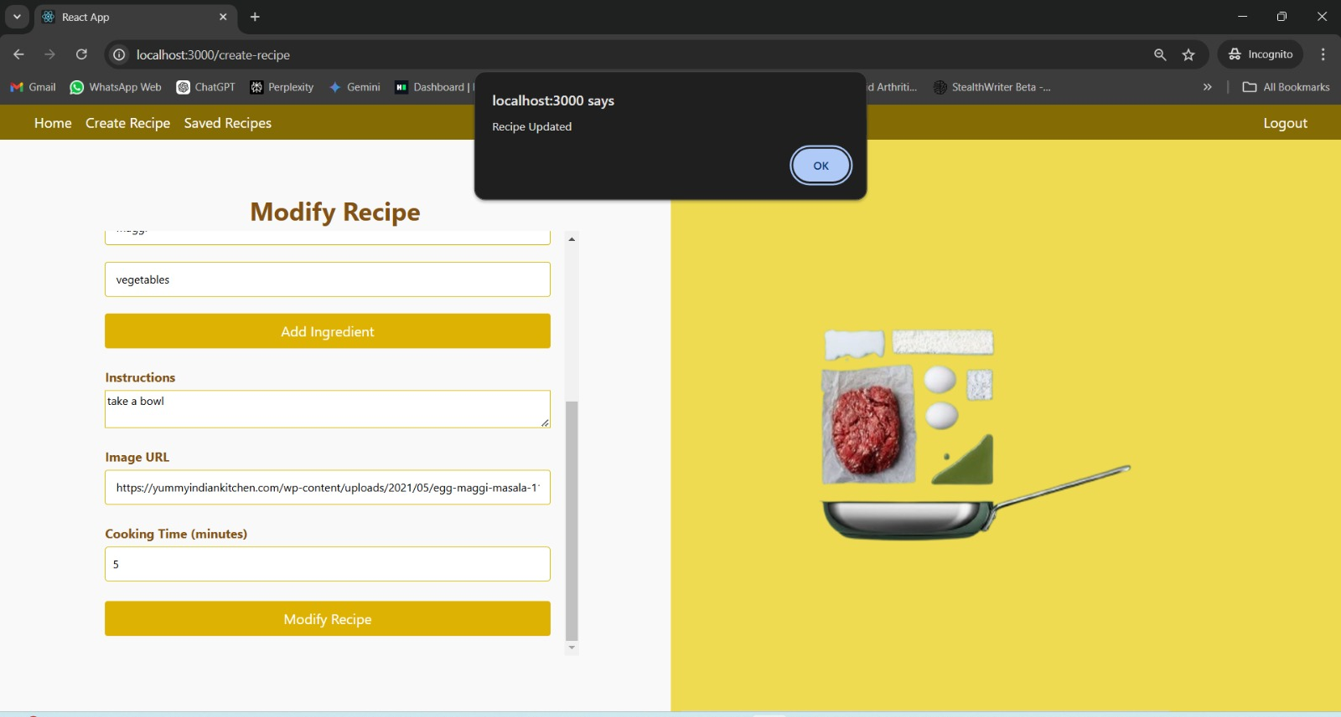
Results

Slide 11
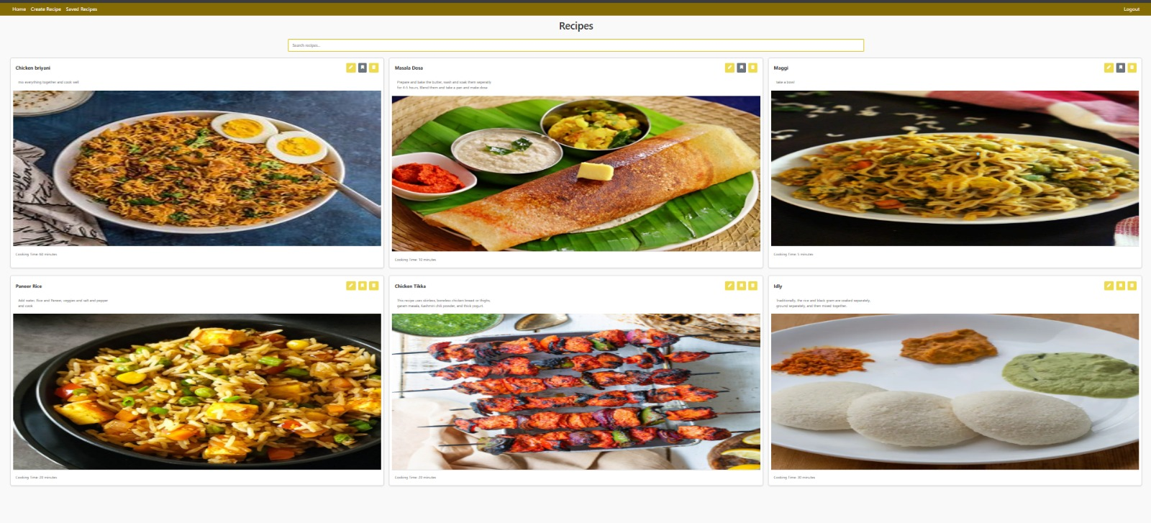
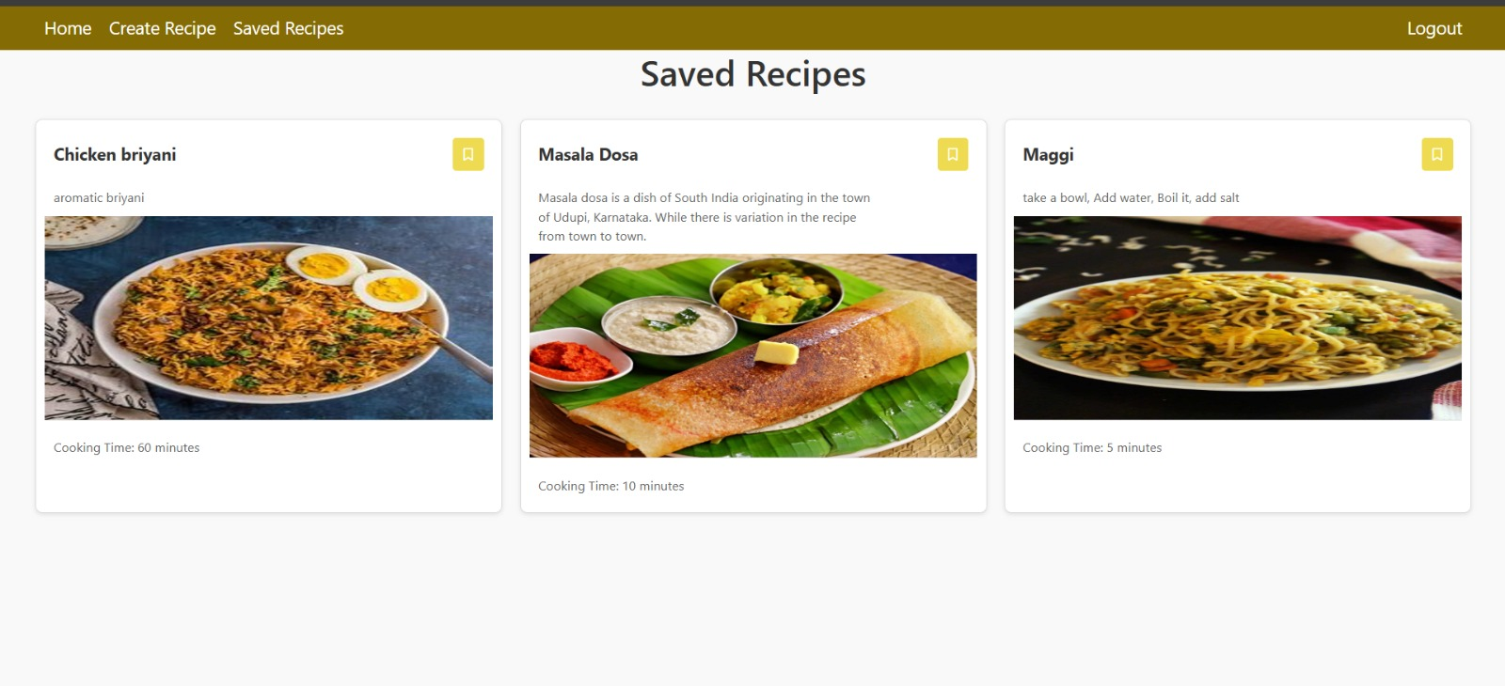
Results

Slide 12
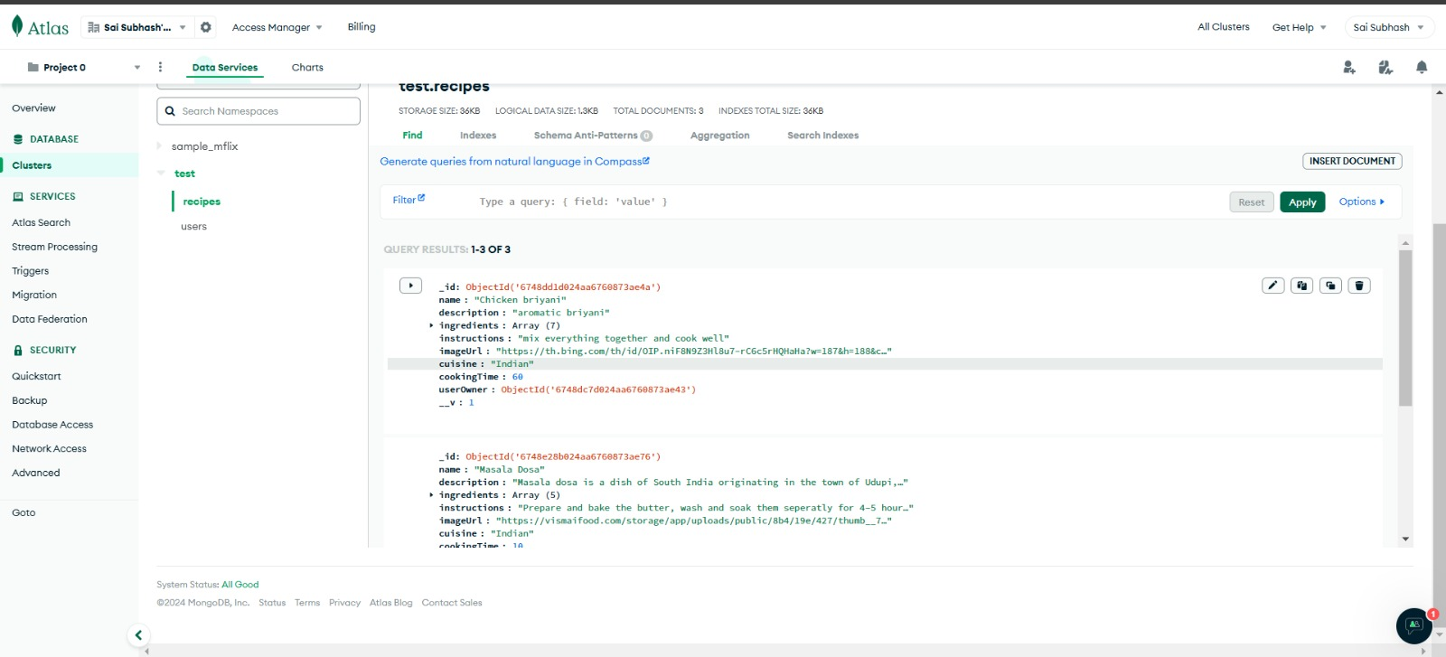
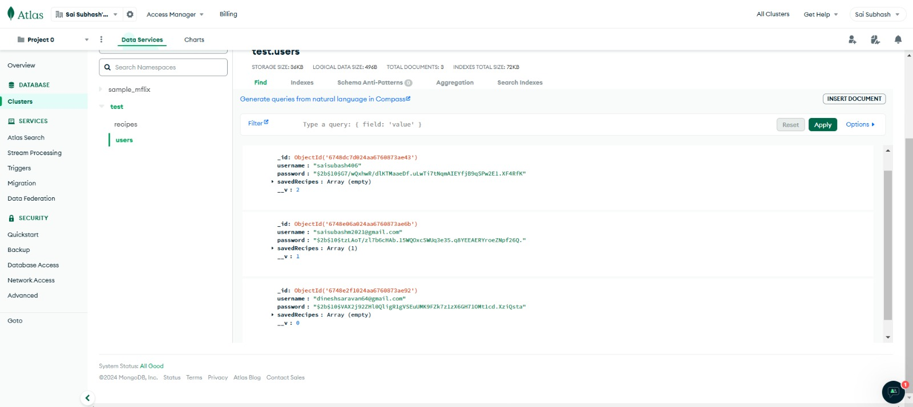
Results

Slide 13
Conclusion
This recipe-sharing platform successfully brings together food enthusiasts from all walks of life, offering a seamless and interactive environment to share, explore, and manage recipes.
With its robust frontend and backend, built using HTML, CSS, JavaScript, React, MongoDB, and Bootstrap, the platform ensures a user-friendly experience while maintaining security and scalability.
The combination of these technologies results in a responsive, efficient, and engaging system that meets the needs of today’s digital food community.

Slide 14
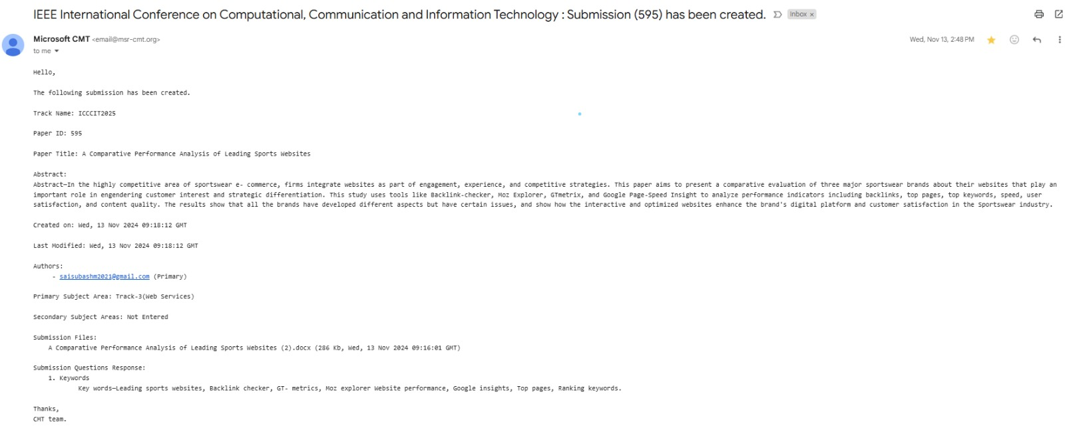
CONFERENCE DETAILS

Slide 15
References
S. S. Pawar, ”Foodies Full Stack Web Application: Connecting You to Your College Canteens,” International Journal for Science Tech- nology and Engineering, vol. 12, no. 10, pp. 709–714, 2024. doi: 10.22214/ijraset.2024.64674.
H. Pitroda, ”A Proposal of an Interactive Web Application Meal Appeal: One Stop Solution for all Meals,” International Journal of Innovative Science and Research Technology (IJISRT), vol. 7, no. 5, pp. 117–134, May 2022. ISSN 2456- 2165.
H. Davis, B. Nansen, F. Vetere, T. Robertson, M. Brereton, J. Durick, and K. Vaisutis, ”Homemade Cookbooks: A Recipe for Sharing,” in Proceedings of the 2014 Conference on Designing Interactive Systems, June 2014, pp. 73–82.
P. Thakur and S. Chandna, ”MISOhungry: A Platform that Encourages Easy Access to Recipe Search, Management, and Traditional Recipes,” in International Conference on Human-Computer Interaction, June 2022, pp. 249–264. Cham: Springer International Publishing.
O. Y. Han, N. A. A. Majid, and M. A. Salleh, ”Tasteonus: The Recipe Mobile Application,” Journal of Applied Technology and Innovation, vol. 7, no. 4, p. 31, 2023.e-ISSN:2600-7304.

Slide 16
Thank You

